Slide 1
Face the Future: Deepfake ML Challenge
Presented By
Team jainshrutd211204
Team Members: Shrut Jain

Slide 2
Abstract of Proposed Solution
The proposed solution utilizes a hybrid dual-branch deep learning model to detect deepfake images in a challenging low-resolution (32x32), diverse-object dataset. One branch employs a pretrained EfficientNetB1 network fine-tuned on 224x224 resized images to extract spatial features, while a custom CNN processes frequency domain features—Disrete Fourier Transform magnitude, phase spectra, and Error Level Analysis maps—at original resolution. These feature sets are concatenated and passed through dense layers with dropout (0.3 & 0.4), Gaussian noise (0.2 std), L2 regularization (0.01), and label smoothing (0.05), ensuring robust learning and overfitting mitigation.
Data augmentation tripled the training data using horizontal flips, rotations, translations, brightness, and contrast adjustments, carefully preserving fragile features. Hyperparameters were optimized using Keras Tuner, yielding training accuracy of 97.34% and validation accuracy of 95%. This fusion of spatial and frequency features enables the model to generalize well despite the absence of face cues and low image quality, making the solution scalable and effective for real-world deepfake detection across varied object categories.123457

Slide 3
Preprocessing Strategy for Low-Resolution Deepfake Detection
Effective data preprocessing is crucial for deepfake detection, especially when dealing with challenging low-resolution imagery. Our dataset presented images at a tiny 32x32 pixel resolution.
Dual-Resolution Input Strategy
EfficientNet Input Requirements
Frequency Domain Conversion
To preserve crucial features, we adopted a dual-resolution approach. The original 32x32 resolution was maintained for the frequency domain analysis branch to prevent loss of subtle textural details.
The images destined for the pre-trained EfficientNet branch were resized to 224x224 pixels. This is the required input size for the pre-trained model to ensure effective and high-quality feature extraction.
Images were converted to grayscale before computing the magnitude and phase spectra via Discrete Fourier Transform (DFT). This captures frequency domain information, which is highly indicative of synthetic artefacts.
To compensate for the limited dataset size and enhance generalization, we applied carefully selected data augmentation techniques that preserve essential image features.
Data Augmentation Specifications:
Each image was augmented threefold using horizontal flip, slight rotation (±5%), minor translations (±5%), brightness adjustment (±10%), and contrast variation (±10%). This strategy increases diversity without disrupting the delicate feature distributions in low-resolution images.

Slide 4


Multi-Modal Feature Extraction and Representation
Our approach enhances detection robustness by fusing complementary features derived from three distinct modalities: frequency domain, error level analysis (ELA), and spatial domain deep features.
Frequency Domain Features
Error Level Analysis (ELA)
Spatial Deep Features
Derived by applying Discrete Fourier Transform (DFT) to obtain magnitude and phase spectra. These features capture image frequency components that often reveal periodic or unnatural manipulation artefacts indicative of deepfakes.
Applied to highlight subtle compression inconsistencies within the image. ELA effectively exposes forgery traces that are not easily visible when viewing raw pixel data, leveraging the fact that manipulated areas are often recompressed differently.
Extracted from the EfficientNetB1 pre-trained convolutional neural network (CNN). This provides high-level semantic information and structural understanding of the image content.
These three modalities—frequency spectra (DFT), ELA maps, and spatial embeddings—were processed through separate network branches and then fused for joint analysis. This multi-branch fusion approach leverages complementary strengths, significantly enhancing the model's ability to detect diverse deepfake artefacts across small, random-object images.

Slide 5
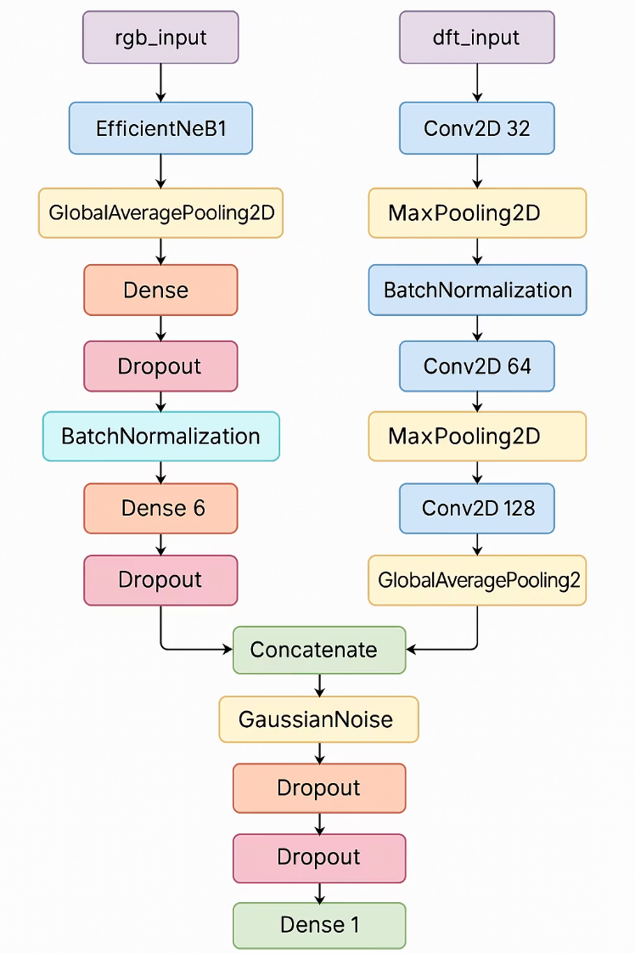
Model Architecture and Training Strategy
We engineered a robust two-branch neural network architecture specifically tailored for multi-modal feature integration in deepfake detection.
The proposed model follows a two-branch hybrid architecture combining spatial and frequency-domain features for robust classification. The Spatial Branch uses a frozen EfficientNetB1 backbone to process 224×224 RGB images, followed by dense layers with ReLU activation, dropout, batch normalization, and L2 regularization.
The Frequency/ELA Branch handles 32×32 magnitude, phase, and ELA inputs using a custom CNN with convolution, max pooling, batch normalization, and dropout layers. Outputs from both branches are concatenated, passed through a GaussianNoise layer for regularization, and further refined by dense layers before a final sigmoid layer performs binary classification.
Key Hyperparameters and Optimisation:
1. Hyperparameters were meticulously optimised using Keras Tuner to ensure peak performance and stability:
2. Regularisation: Dropout (0.3 and 0.4), L2 Regularisation (0.01), Gaussian Noise std (0.2).
3. Loss Function: Binary Cross-Entropy with Label Smoothing (0.05) to discourage over-confidence in predictions and improve generalization.
4. Learning Rate: Optimized to a precise 0.0001 for stable convergence.
The model was trained using the Adam optimizer, incorporating early stopping based on validation loss and a dedicated validation split to effectively mitigate overfitting.

Slide 6
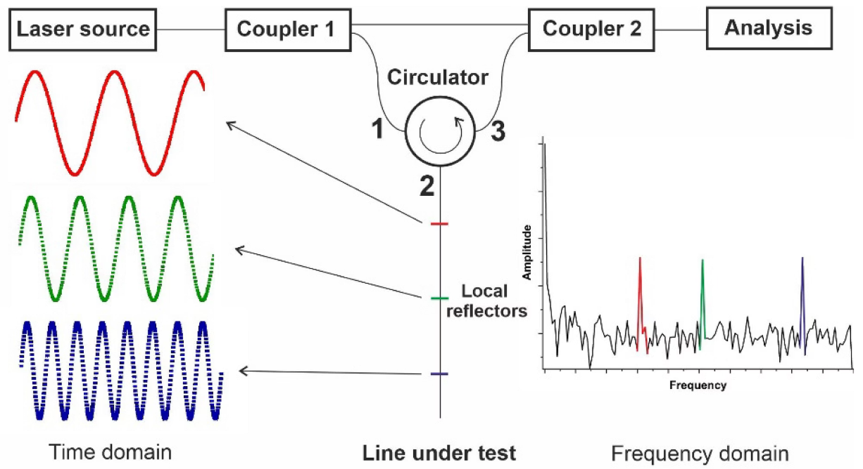
Reasoning behind the chosen approach: Hybrid Detection Framework
Our choice of a multi-modal detection framework is based on the inherent limitations and identifiable signatures of deepfake generation processes.
Exploiting Frequency Domain Anomalies
Robustness Across Artefact Types
AI-generated images frequently exhibit anomalies in their frequency distributions, such as uneven or unrealistically smooth spectral patterns. The Discrete Fourier Transform (DFT) is highly effective at isolating these issues by extracting magnitude and phase spectra. This allows us to target artefacts invisible to the human eye, which are often overlooked by purely spatial models.
The combined approach ensures high resilience against diverse deepfake artefacts, whether they manifest as subtle textural inconsistencies (ELA/Frequency) or high-level semantic flaws (Spatial).
Optimised for Low Resolution
By maintaining the original 32x32 resolution for the frequency branch, we preserve the critical low-level detail essential for detecting subtle manipulations in constrained inputs.
Complementing with Spatial Features
While frequency is key, image manipulations also affect spatial structure. Leveraging EfficientNetB1 ensures the model captures semantic and structural information, providing context for the frequency analysis. The integration of ELA adds a vital layer of protection against compression-based forgery methods.

Slide 7
Overcoming Challenges in Low-Resolution Deepfake Analysis
The process of training a robust deepfake detector on a low-resolution dataset presented distinct technical hurdles, primarily concerning feature preservation and model generalisation.
Challenge 3: Preventing Overfitting
Challenge 2: Balancing Augmentation
Challenge 1: Small Size and Low Quality
Working with a relatively small, balanced dataset creates a high risk of the model memorising training examples rather than learning generalisable features.
The delicate nature of deepfake artefacts means excessive data augmentation (rotation, shear, etc.) can easily dilute or destroy the subtle frequency characteristics that the model is trained to detect.
The initial 32x32 resolution severely limits available pixel information and risks feature degradation during any necessary upscaling or complex augmentation.
Solution: A comprehensive suite of regularisation methods was employed: dropout, L2 regularisation, Gaussian noise injection, and label smoothing were crucial in stabilising the learning process and ensuring robust generalisation.
Solution: We employed the dual-branch strategy, maintaining 32x32 resolution for the frequency domain analysis to preserve subtle, low-level artefact signals.
Solution: Augmentation was strictly limited to minor, conservative transformations (±5% rotation/translation, minor brightness/contrast shifts) that preserve the core frequency signature.

Slide 8
Model Evaluation: Highly Accurate and Balanced Performance
The final fused multi-modal model demonstrated exceptional performance, achieving high accuracy and balanced metrics across both real and fake classifications on the validation set.
97.34%
95%
Class
Precision
Recall
F1-Score
Support
Real (0)
0.95
0.95
0.95
637
Training Accuracy
Validation Accuracy
Fake (1)
0.95
0.95
0.95
643
High confidence in feature learning across the training data.
Strong indication of generalisation ability on unseen data.
Overall
0.95
—
—
1280
The following metrics demonstrate the model's balanced classification effectiveness, confirming high precision and recall for both classes.
Most optimised Threshold achieved by ROC Curve: 0.509
The near-identical precision and recall scores of 0.95 for both 'Real' and 'Fake' classes underscore the model's ability to generalise effectively across class boundaries. This result validates the multi-modal fusion approach, confirming that the combination of frequency, ELA, and spatial features provides a robust foundation for deepfake detection in challenging low-resolution environments.

Slide 9
Thank You!

